Slide 1
Phase Transitions for Graph Colouring
Raphael Groarke
Vrije Universiteit

Slide 2
Introduction
Peter Cheeseman wrote a paper called “Where the really hard problems are”
I am attempting to replicate one of the experiments covered in that paper

Slide 3

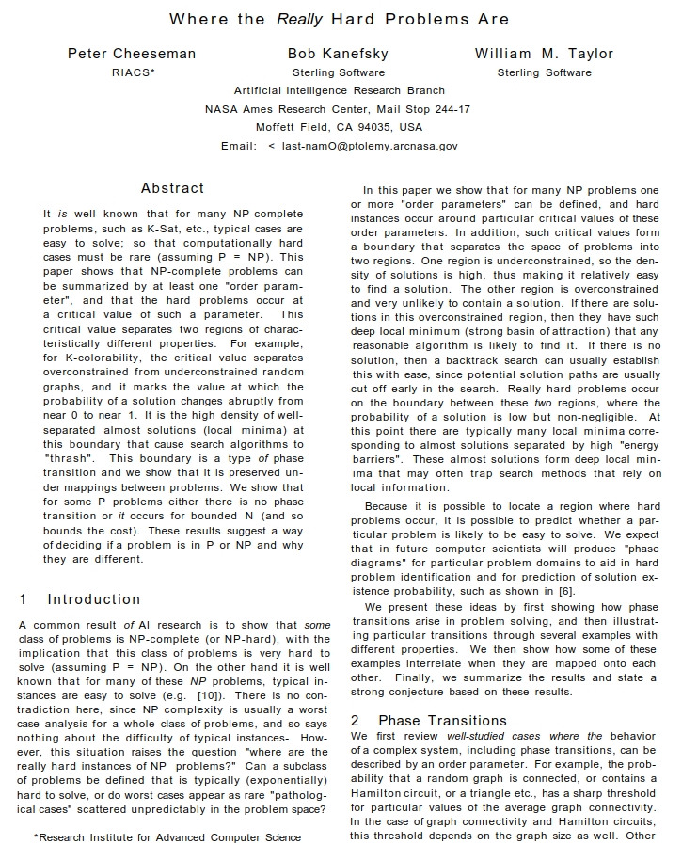
The Original Paper
There is a boundary for a type of problem where the computation cost increases dramatically
Trying to prove that this phase transition exists for a set of existing problems:
Hamilton Circuits
Graph Colouring
K-Satisfiability
Asymmetric Traveling Salesman
Peter Cheeseman
https://independent.academia.edu/PeterCheeseman

Slide 4

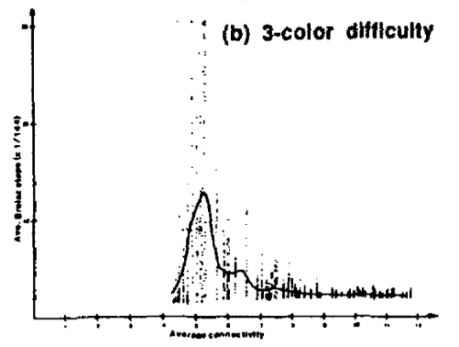
What to Expect
Better plots
Previous mistakes found about ATSP
Discrepancies about the algorithm

Slide 5
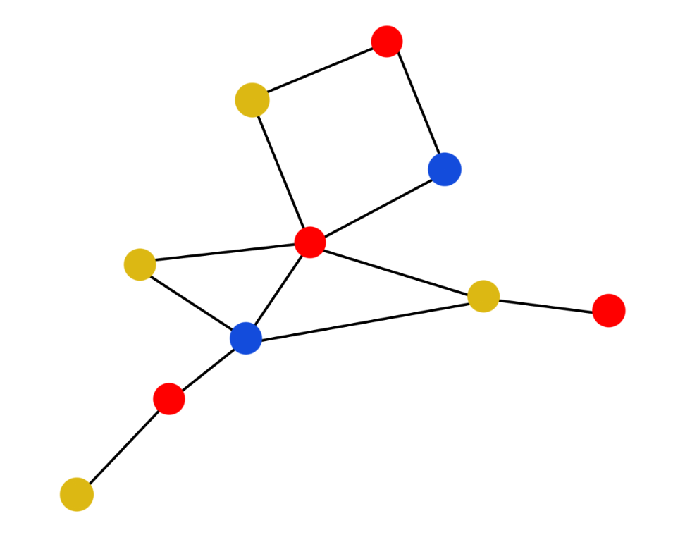
Graph Colouring
Find a minimal colouring for a graph
The constraint: No two neighbouring nodes can share a colour

Slide 6
Graph Colouring
Clique of size 3
Clique: induced fully connected subgraph

Slide 7
The Original Algorithm
The first algorithm mentioned is unclear
Ambiguous sources
Second algorithm which is described cannot be used

Slide 8
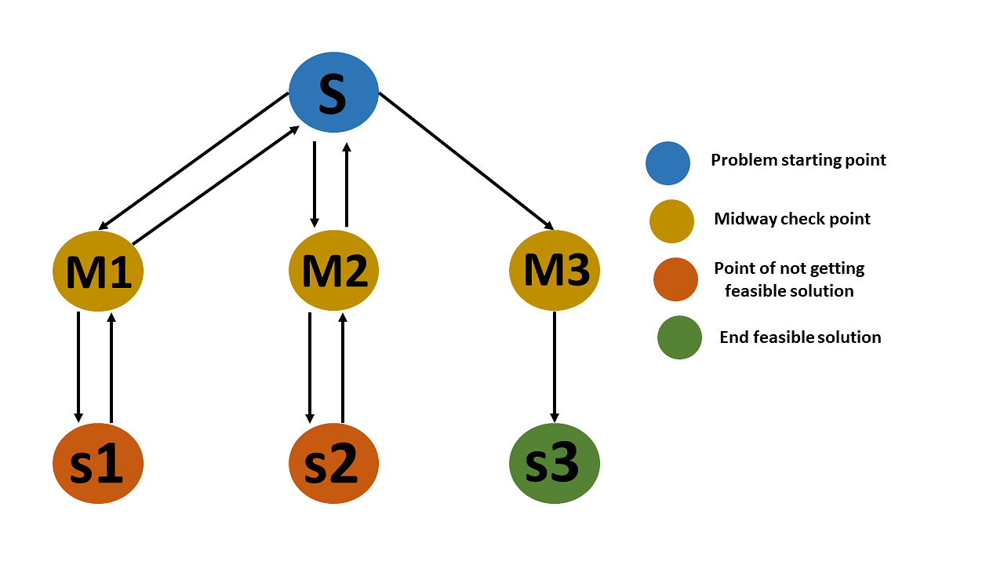
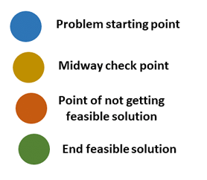
My Algorithm
Backtracking algorithm
Recursion cap of 1 billion
https://www.simplilearn.com/tutorials/data-structure-tutorial/backtracking-algorithm

Slide 9
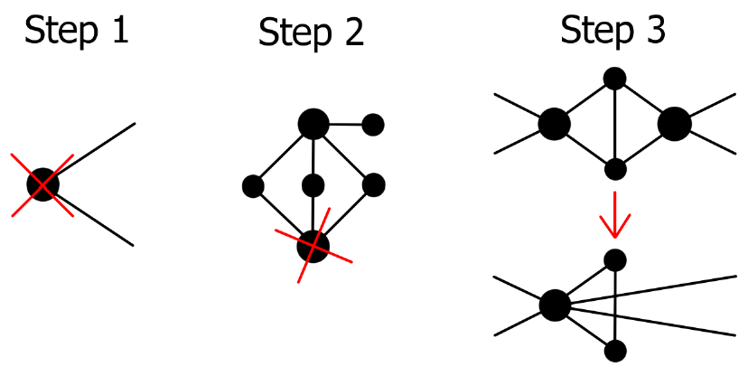
My Data
270 Graphs
Average connectivity step of 0.5
10 graphs per average connectivity
Reduced graphs
Recreation of Cheeseman’s diagrams

Slide 10

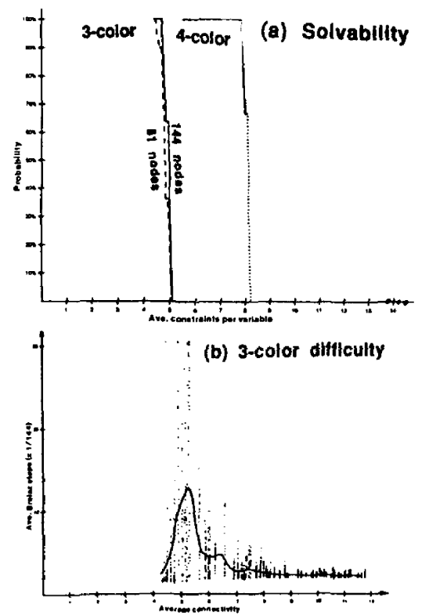
Findings From Original Paper
Horizontal axis: average connectivity per node
Original plots are only partially legible
https://www.ijcai.org/Proceedings/91-1/Papers/052.pdf

Slide 11
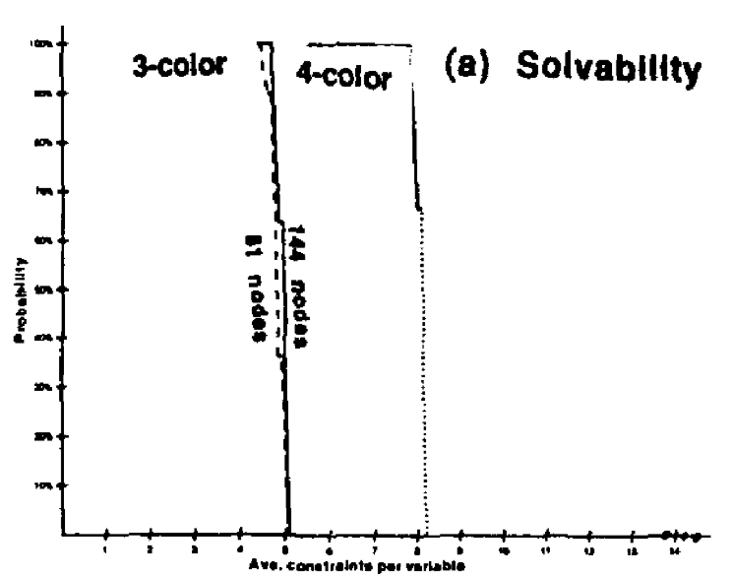
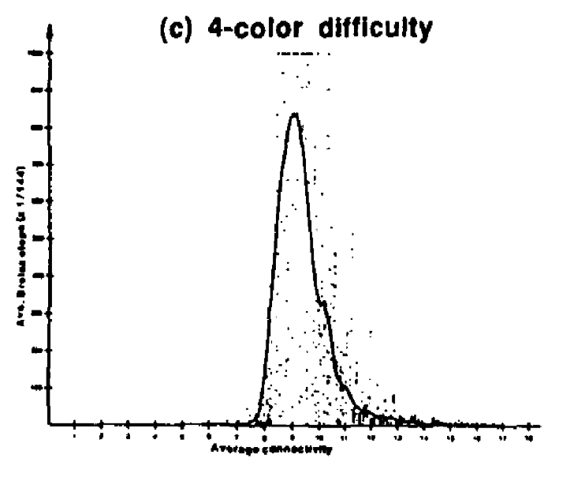
Probability
Avg. Brelaz step (= 1/144)
Average Connectivity
Average Connectivity
https://www.ijcai.org/Proceedings/91-1/Papers/052.pdf

Slide 12
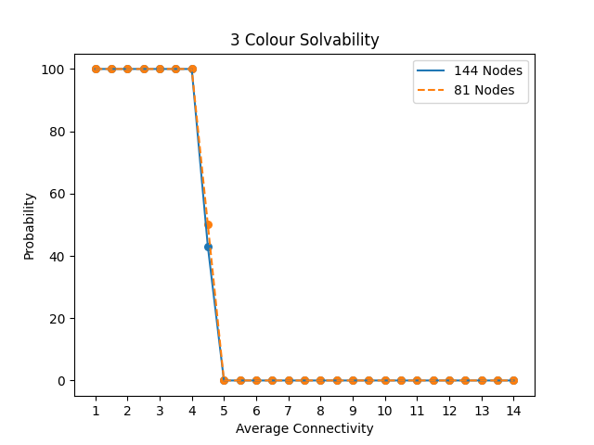
My Results
Different probabilities
3 undecided graphs at average connectivity 4.5 for graphs with 144 nodes

Slide 13
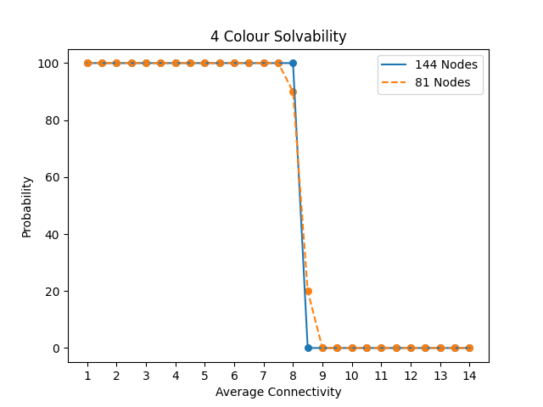
My Results
Different probabilities again
Many undecided graphs for graphs with 144 nodes
5 undecided graphs at average connectivity 8.5 for graphs with 81 nodes

Slide 14
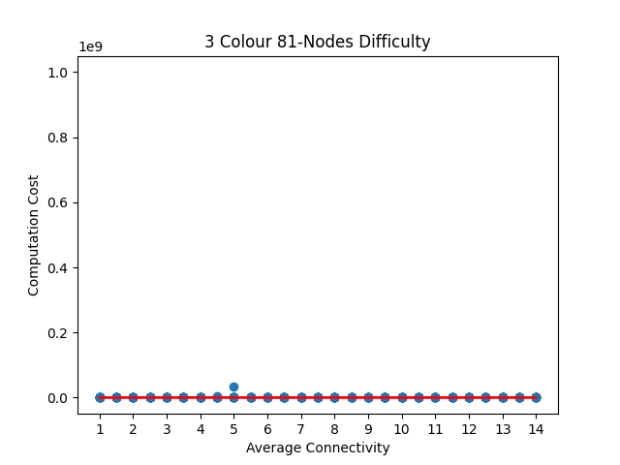
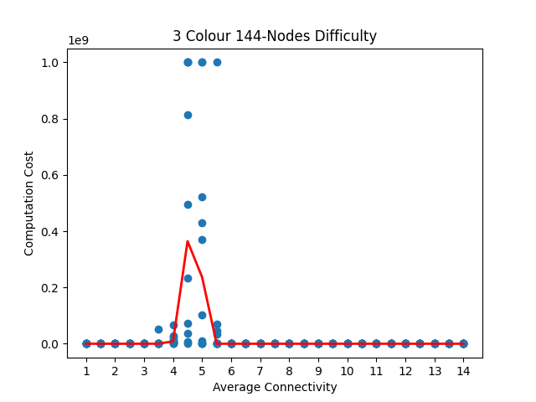
3 Colour Difficulty
Computation Cost
Computation Cost
Average Connectivity
Average Connectivity

Slide 15
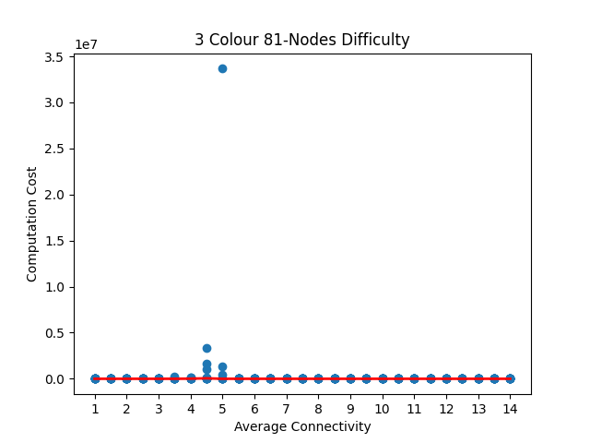
3 Colour Difficulty
Computation Cost
Computation Cost
Average Connectivity
Average Connectivity

Slide 16
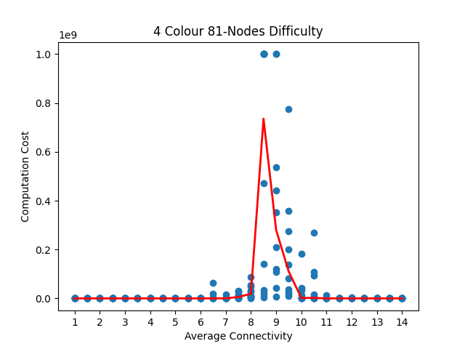
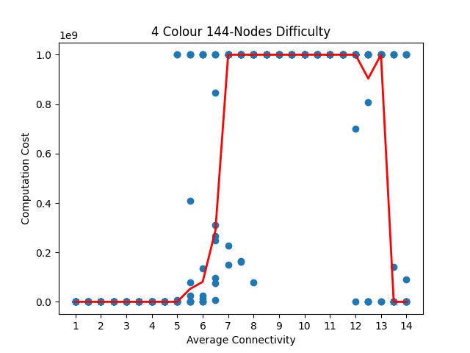
4 Colour Difficulty
Computation Cost
Computation Cost
Average Connectivity
Average Connectivity

Slide 17
Conclusion
Different probabilities
My results still coincide with Cheeseman’s original conjecture

Slide 18
Thank you!
Questions?

